Slide 1
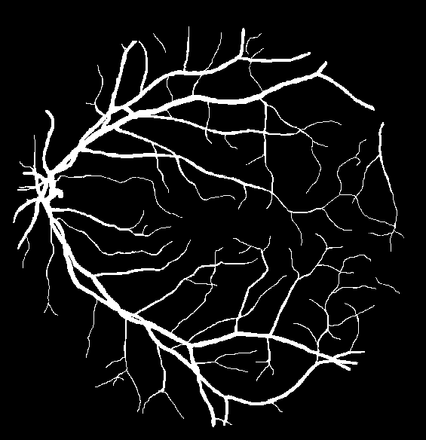
Enhancing Cardiovascular Disease Diagnosis through Deep Learning Analysis of Retinal Images
Presented By: Pranav Gujjar
100443924

Slide 2
Motivation:
CVDs are the leading global cause of death, with 17.9 million deaths annually, emphasizing the need for lifestyle changes and health policies WHO (2024a).
AI enhances CVD screening by improving accuracy, early detection, and reducing healthcare provider workloads.
Retinal imaging with AI offers a non-invasive, rapid, and accessible tool for early CVD diagnosis, promoting equitable healthcare.
Refrence : https://www.who.int/health-topics/cardiovascular-diseases#tab=tab_1 (cvds).

Slide 3
Aim :
Design, develop and validate a Deep Learning model for automatically analysing retinal images to support the diagnosis and monitoring of a constrained vascular-related diseases
Objectives:
c
Examine and select appropriate datasets that are available to the public for the model’s training and testing ( Available Datasets like DRIVE DRI (2024), STARE Hoover et al.(2000), CHASE DB1 Fraz et al. (2012)).
Examine modern deep learning approaches and models for image segmentation analysis to choose the best model for this project.
Design a deep learning model to segment retinal image vascular networks using the TensorFlow framework.
Use performance metrics such as Accuracy, DICE and Jaccard indices to evaluate the model’s accuracy and efficiency.
References: Drive: Digital retinal images for vessel extraction. https://drive.grand-challenge.org/DRIVE/.
Hoover, A., Kouznetsova, V., and Goldbaum, M. (2000). Stare: Structured analysis of the retina dataset.
Fraz, M. M., Remagnino, P., Hoppe, A., Uyyanonvara, B., Rudnicka, A. R., Owen, C. G., and Barman, S. A. (2012). Chase db1: Retinal vessel
reference dataset.

Slide 4
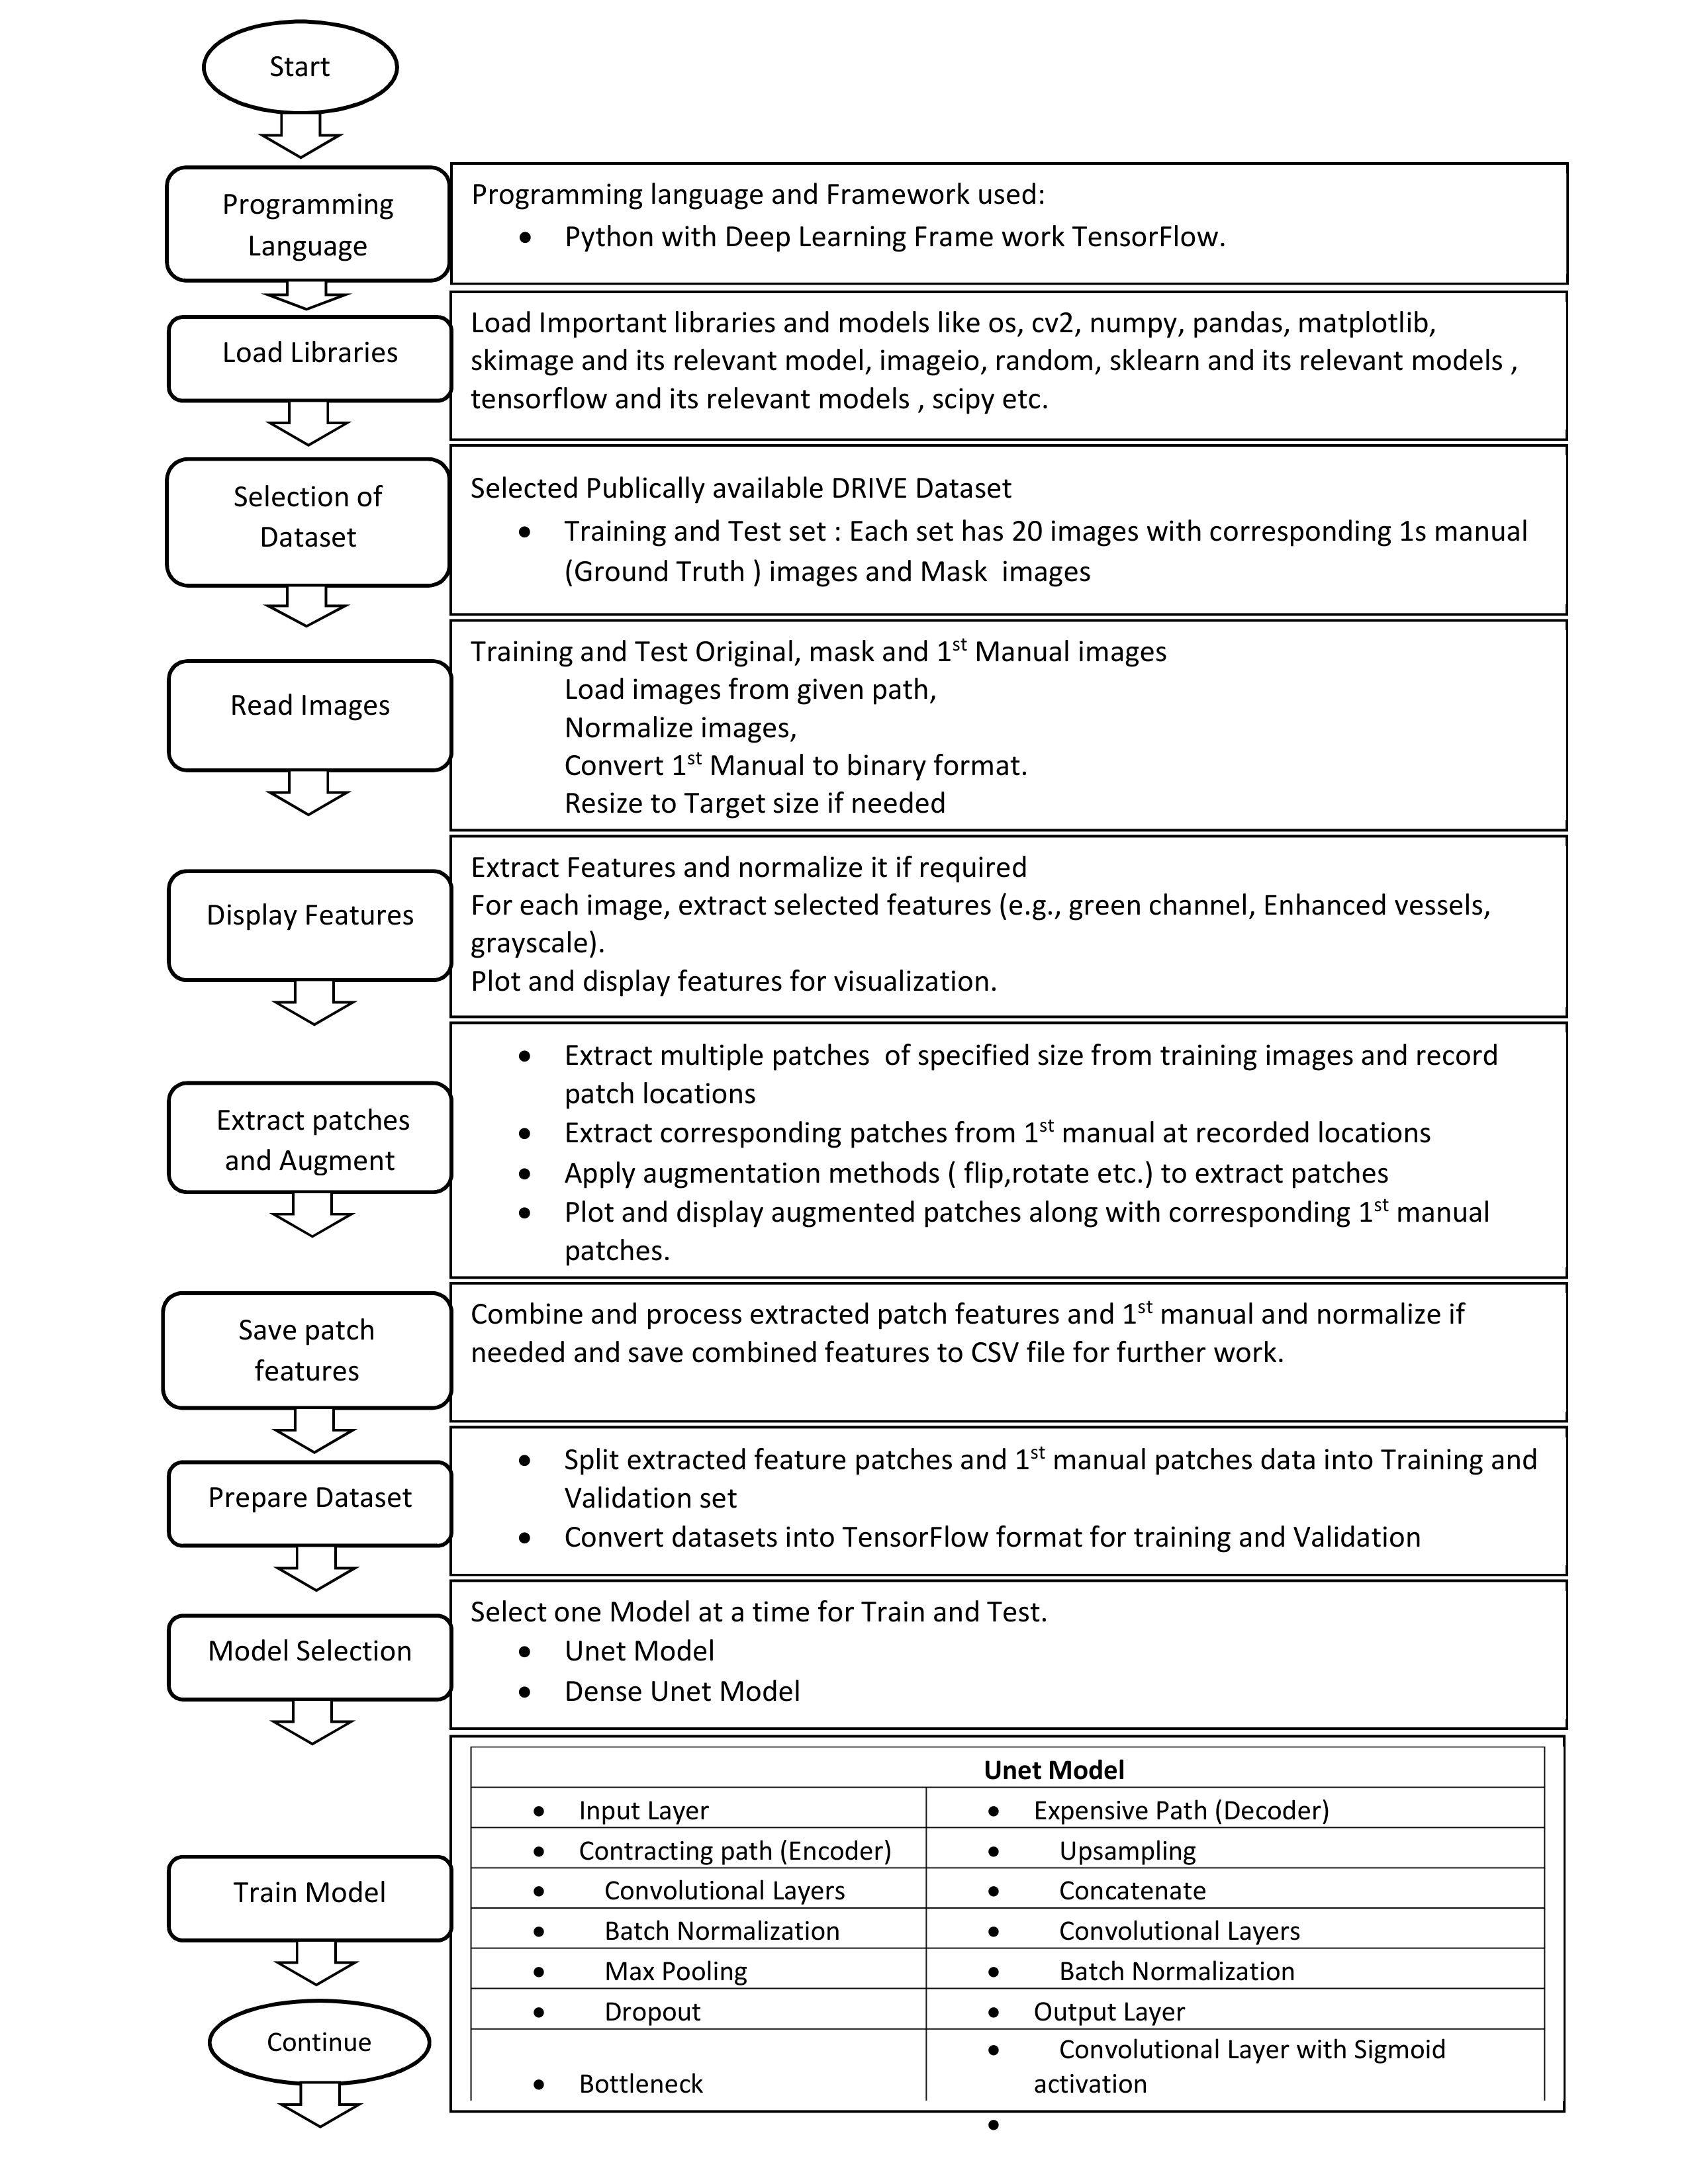
Methodology :

Slide 5
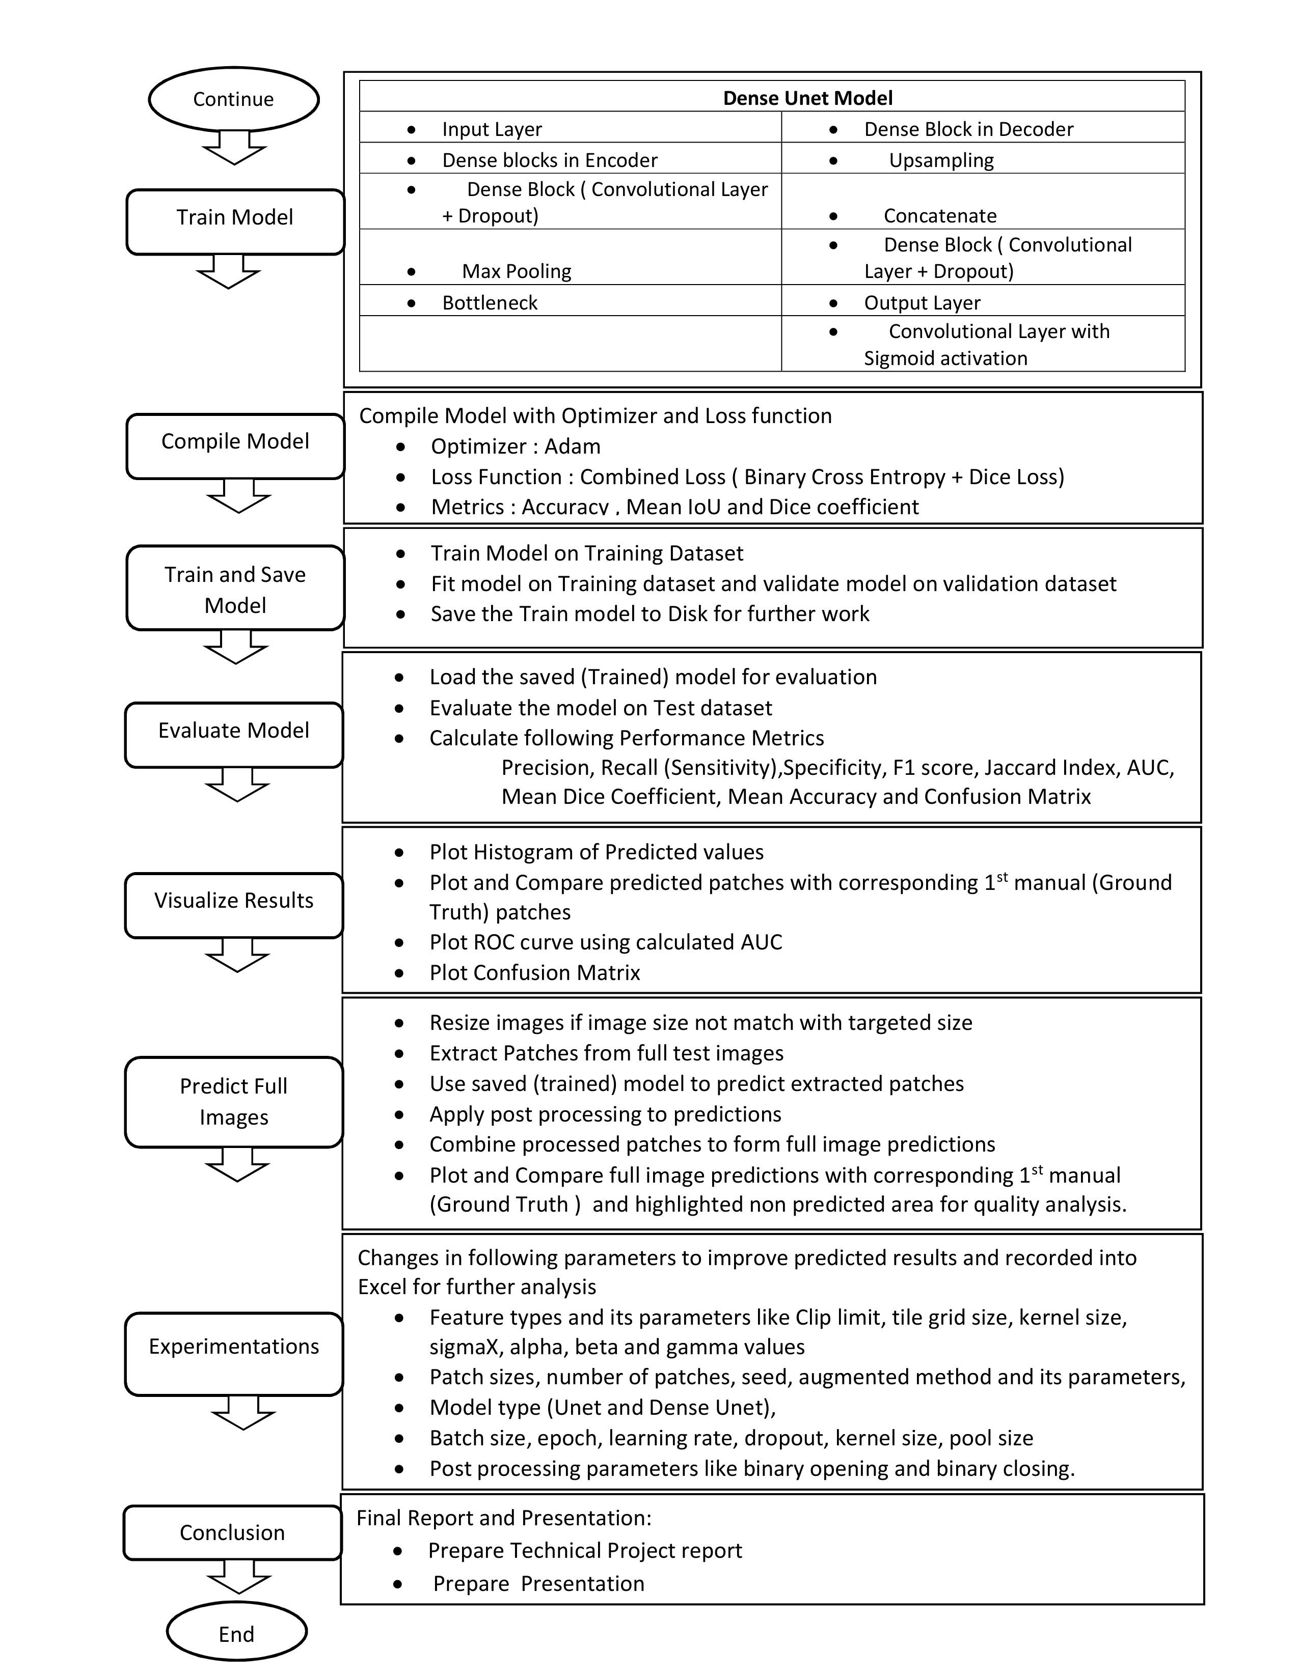
Methodology :

Slide 6
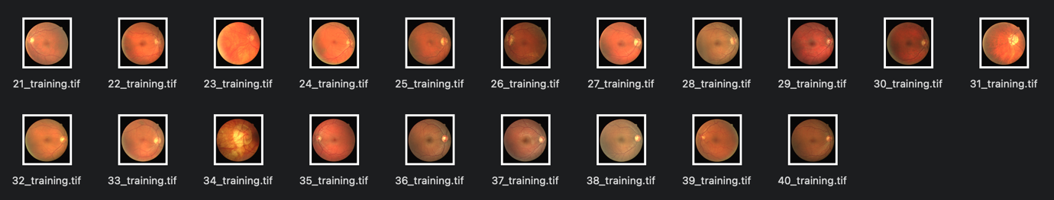

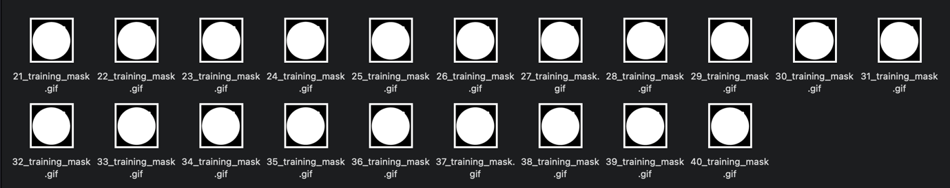
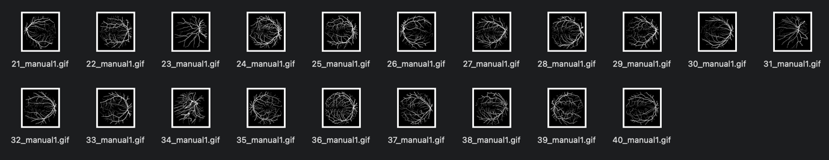
# DRIVE : Training Dataset Images
Source Image
Mask Image
Ground Truth Image

Slide 7
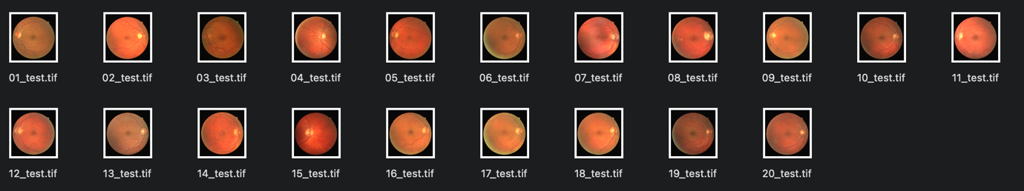

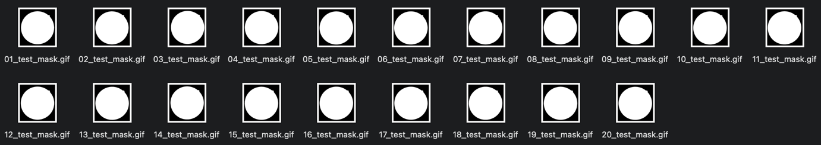
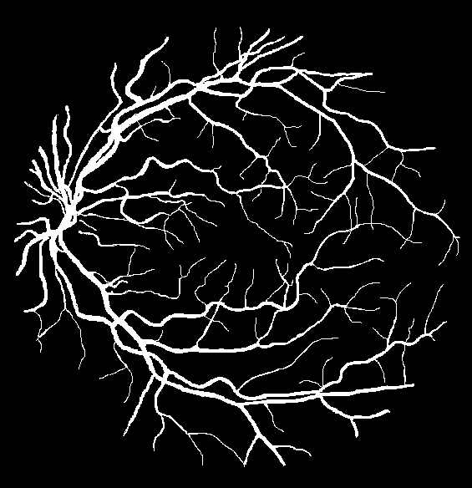
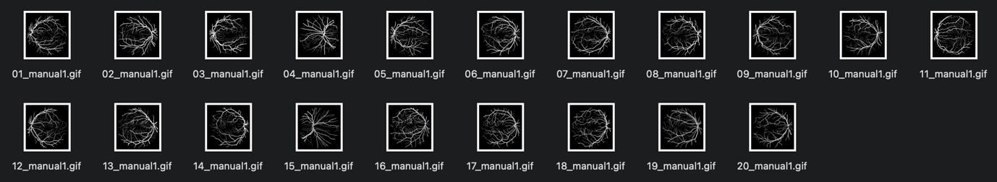
# DRIVE : Test Dataset Images
Source Image
Mask Image
Ground Truth Image

Slide 8
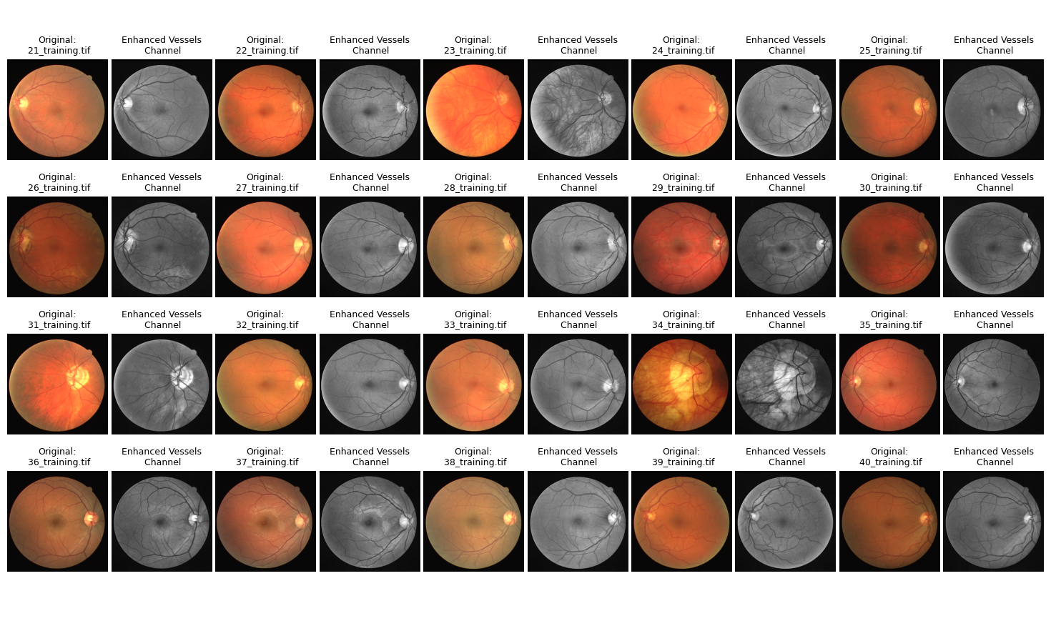
# Extracted Feature With Source Image Comparison

Slide 9
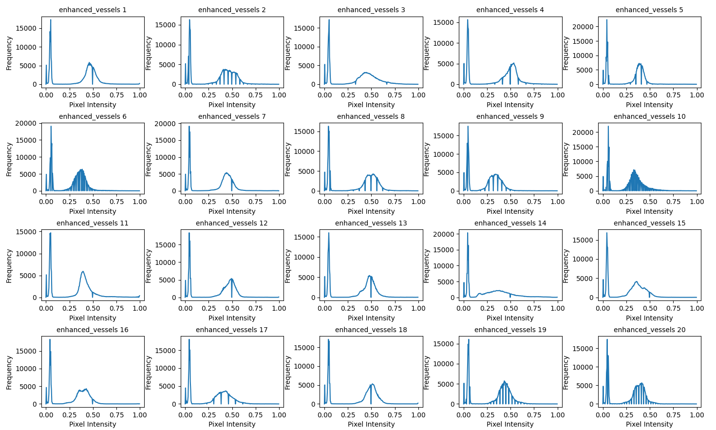
# Pixel Intensity Distribution of Feature Extracted image

Slide 10
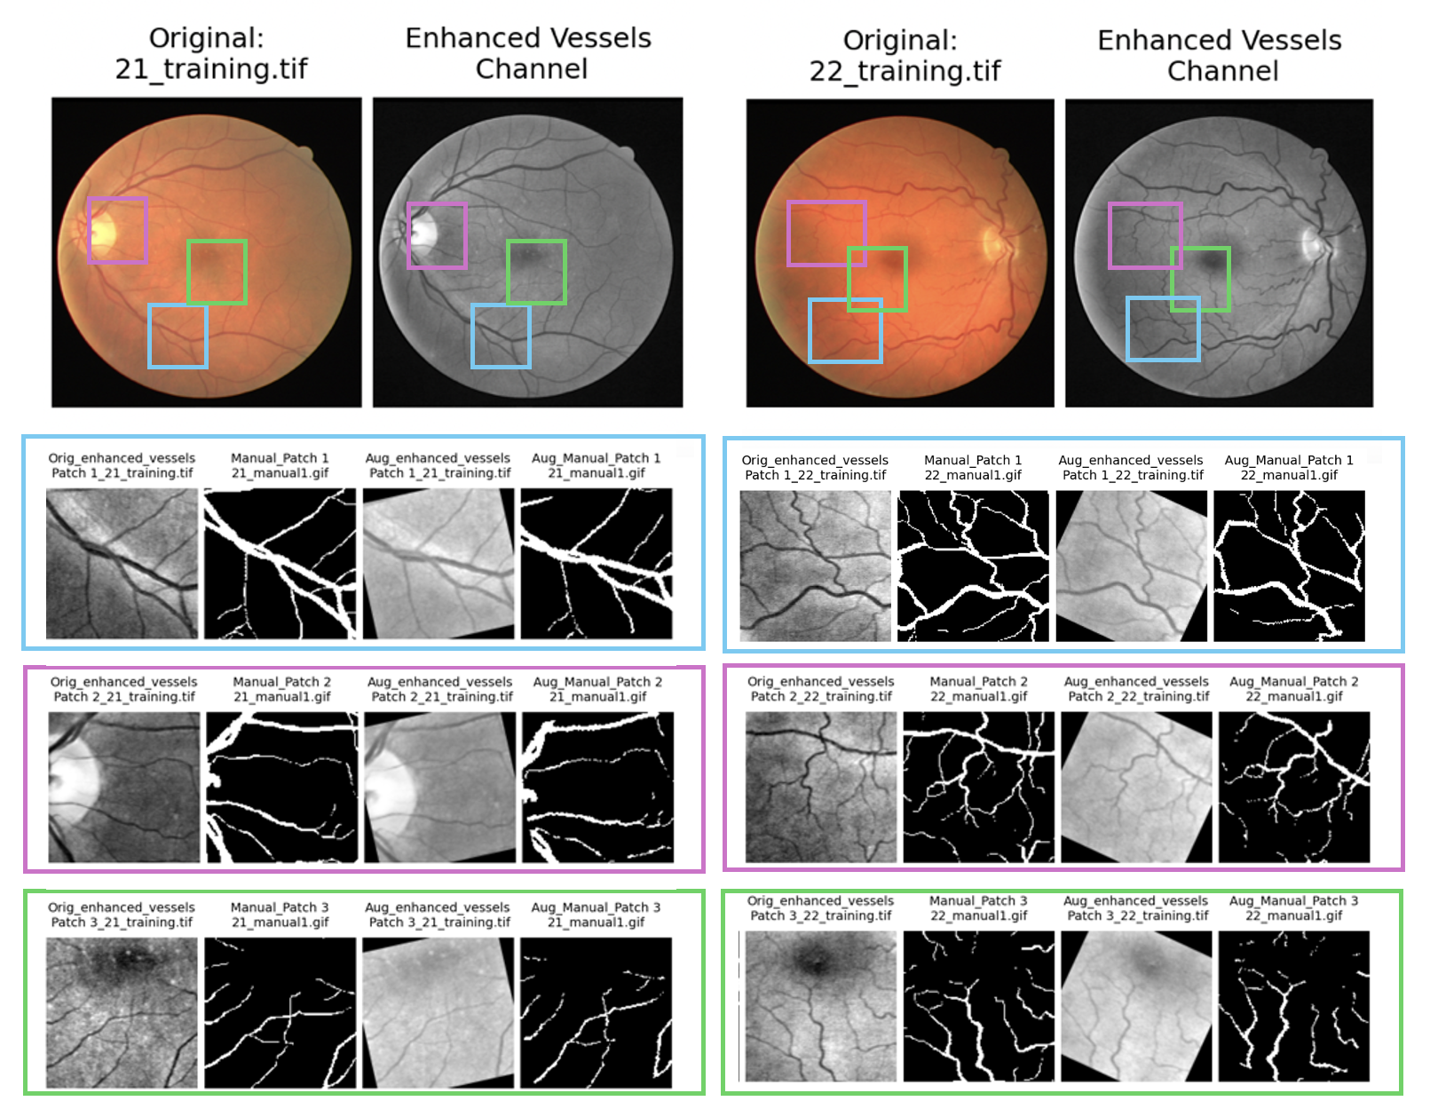
# Patch extractions and Data Augmentation Visualization

Slide 11
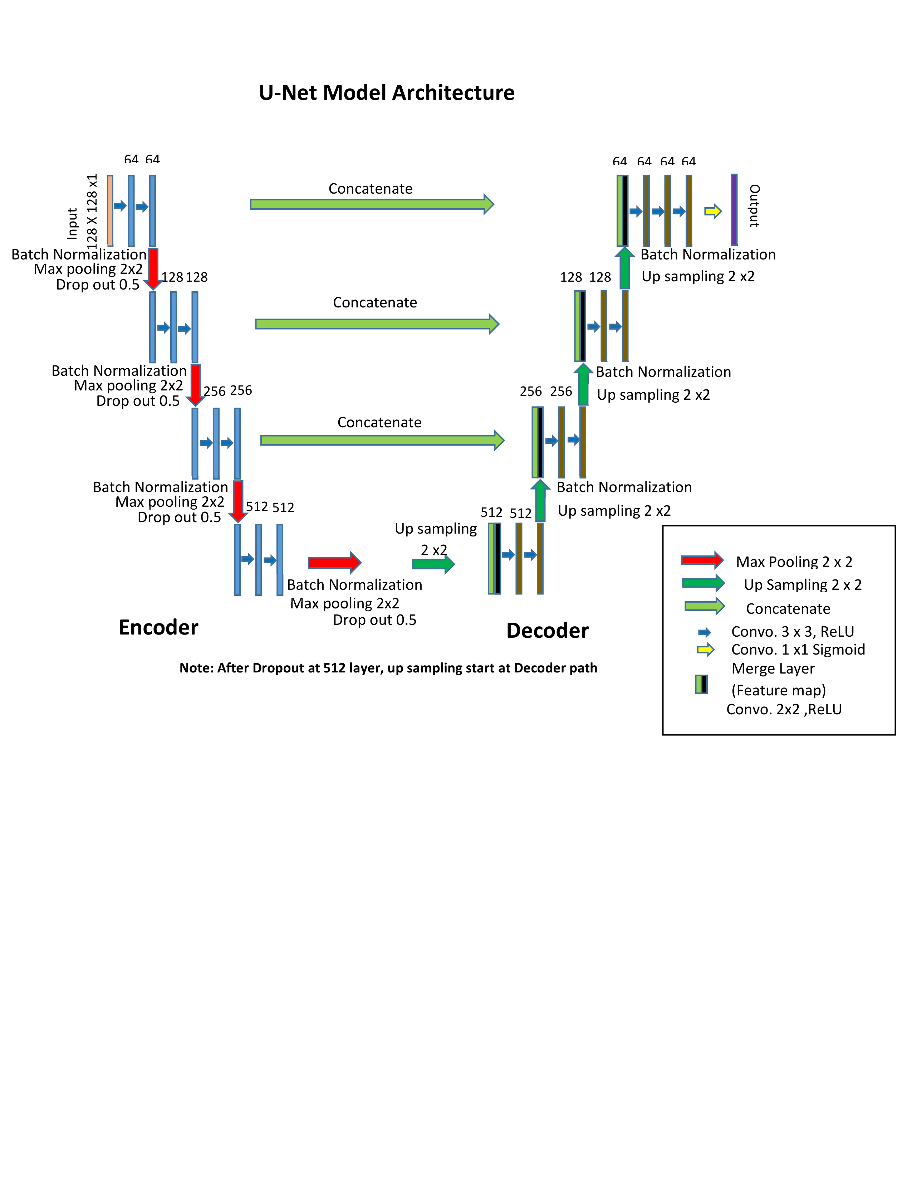
# U-net Model Architecture
Reference : Ronneberger, O., Fischer, P., and Brox, T. (2015). U-net:Convolutional networks for biomedical image segmentation. CoRR, abs/1505.04597

Slide 12
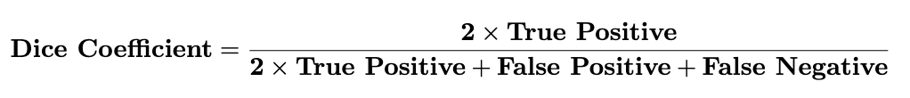
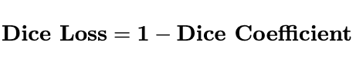
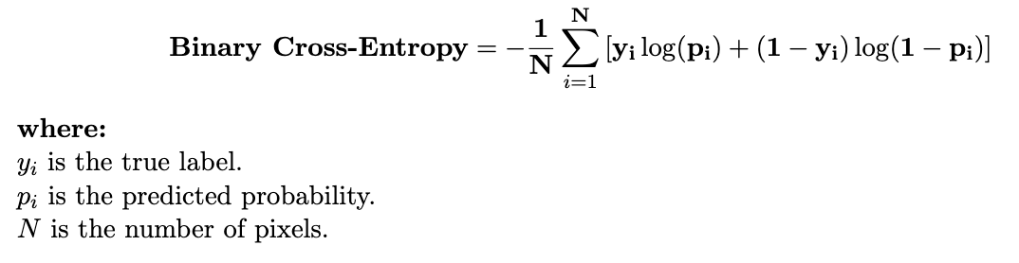
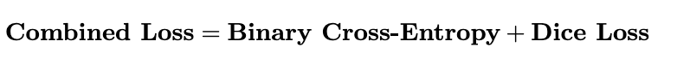
# Important equations for Predicted Results:
- Parsad, N. M. (2018).
- Yeung et al. (2023):
- Goodfellow et al. (2016a):
References : Parsad, N. M. (2018). Deep learning in medical imaging. DataDrivenInvestor.
Yeung, M., Rundo, L., Nan, Y., et al. (2023). Calibrating the dice loss to handle neural network overconfidence for biomedical image segmentation. Journal of
Digital Imaging, 36:739–752.
Goodfellow, I., Bengio, Y., and Courville, A. (2016a). Deep Learning. MIT Press. Chapter 6 discusses loss functions, including binary cross-entropy.

Slide 13
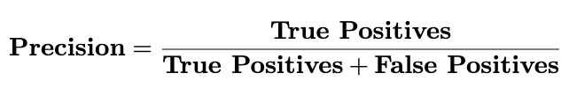

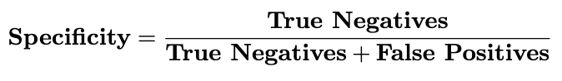
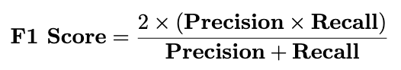
# Important equations for Predicted Results:
-Gupta (2021):
-Gupta (2021):
- Taha and Hanbury (2015).
-Gupta (2021):
References: Gupta, J. (2021). Sometimes accuracy is not the right metric. Connect Jaya
Taha, A. A. and Hanbury, A. (2015). Metrics for evaluating 3d medical image segmentation: analysis, selection, and tool. BMC Medical Imaging,
15:29.

Slide 14
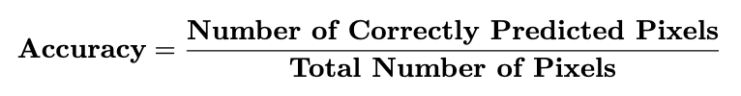
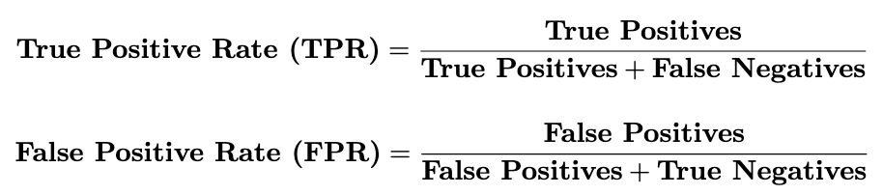
# Important equations for Predicted Results:
- Sanjaya et al. (2020):
- Buhl (2022):
Area under curve (AUC):
- Boesch(2024):
References: Sanjaya, Y., Gunawan, A., and Irwansyah, E. (2020). Semantic segmentation for aerial images: A literature review. Engineering, MAthematics
and Computer Science (EMACS) Journal,2:133–139.
Buhl, N. (2022). Guide to image segmentation in computer vision: Best practices. Encord Blog.
Boesch, G. (2024). Precision vs. recall – full guide to understanding model output. Viso.ai.

Slide 15
# U-net Model Initial Experiment Configuration and results
Configuration Description | Parameter values
Target image size | 512 x 512
Feature Type | Enhance_vessel
Data Augmentation method | flip & rotate [-45 , 45]
Patch Size | 128
Number of Patches (N_P) | 100,150,200,250,300,350,400,500
Normalization | TRUE
Learning rate | 1.00E-04
Batch Size | 8
Epoch | 5
Seed | 30
Threshold value for prediction | 0.5
Unet model input size | 128 ,128,1
Unet model layers | 64 , 128, 256 , 512
Dropout | 0.5
Unet model details | Conv layer ,,Batch Normalization ,Maxpooling2D, Dropout
Extracted Feature Parameters | Clip Limit: 2,tilegridsize:6x6,Kernel size: 3x3, sigmaX: 0, alpha:1.5, blurred:-0.5,gamma:0
Post Process Parameters | Binary Opening (1,1), Binary Closing(3,3)
Description | N_P_200 | N_P_250
Precision: | 0.8174 | 0.8148
Recall (Sensitivity): | 0.7588 | 0.7567
Specificity: | 0.9789 | 0.9789
F1 Score: | 0.7870 | 0.7847
Jaccard Index: | 0.6488 | 0.6456
AUC: | 0.9716 | 0.9712
Mean Dice Coefficient: | 0.7636 | 0.7577
Mean Accuracy | 0.9545 | 0.9546
Confusion Matrix: | [[57046024 1230616] | [[71413912 1541940]
 | [ 1751055 5508305]] | [ 2181240 6782908]]

Slide 16
# U-net Model 2nd Experiment Configuration and Predicted Results
Extract Feature description | Increase contrast with reduce noise-EF1 | Reduce noise and lower contrast parameters- EF2 | Reduce noise and lower contrast parameters- EF3 | Reducenoise and lower contrast parameters EF4
cliplimit | 3 | 1 | 1 | 1
tile gridsize | 8,8 | 8,8 | 4,4 | 8,8
Kernal isze(kszie) | 5,5 | 3,3 | 3,3 | 3,3
sigma | 0 | 0 | 0 | 0
alpha | 2 | 1 | 1 | 1
blurred | -0.5 | -0.3 | -0.3 | 0
gamma | 0 | 0 | 0 | 0
Binary opening | 2,2 | 1,1 | 1,1 | 1,1
Binary closing | 2,2 | 1,1 | 1,1 | 1,1
Description | N_P_200 | N_P_200 | N_P_200 | N_P_200
Precision: | 0.7555 | 0.8262 | 0.7867 | 0.8177
Recall (Sensitivity): | 0.8205 | 0.7701 | 0.8103 | 0.7781
Specificity: | 0.9669 | 0.9798 | 0.9726 | 0.9784
F1 Score: | 0.7867 | 0.7972 | 0.7983 | 0.7974
Jaccard Index: | 0.6484 | 0.6627 | 0.6643 | 0.6630
AUC: | 0.9745 | 0.9727 | 0.9730 | 0.9713
Mean Dice Coefficient: | 0.7643 | 0.7723 | 0.7761 | 0.7752
Mean Accuracy | 0.9507 | 0.9566 | 0.9547 | 0.9562
Confusion Matrix: | [[56349296 1927344] | [[57100615 1176025] | [[56681666 1594974] | [[57017141 1259499]
 | [ 1303044 5956316]] | [ 1669008 5590352]] | [ 1377023 5882337]] | [ 1610989 5648371]]

Slide 17
# U-net Model further experiments and results
Description | Reduce noise and lower contrast parameters- EF3 N_P_200 | Reduce noise and lower contrast parameters- EF3 N_P_250 | Remove unet layer 512 for experiment LR04-EF3
Precision: | 0.7867 | 0.8078 | 0.8021
Recall (Sensitivity): | 0.8103 | 0.7972 | 0.8005
Specificity: | 0.9726 | 0.9767 | 0.9754
F1 Score: | 0.7983 | 0.8025 | 0.8013
Jaccard Index: | 0.6643 | 0.6701 | 0.6685
AUC: | 0.9730 | 0.9734 | 0.9734
Mean Dice Coefficient: | 0.7761 | 0.7784 | 0.7798
Mean Accuracy | 0.9547 | 0.9571 | 0.9560
Confusion Matrix: | [[56681666 1594974] | [[71255981 1699871] | [[56842871 1433769]
 | [ 1377023 5882337]] | [ 1817811 7146337]] | [ 1448219 5811141]]

Slide 18
# U-net Model final experiment Configuration and predicted results
Configuration Description | Parameter values
Target image size | 512 x 512
Feature Type | Enhance_vessel
Data Augmentation method | flip & rotate [-45 , 45]
Patch Size | 128
Number of Patches (N_P) | 250
Normalization | TRUE
Learning rate | 1.00E-04
Batch Size | 8
Epoch | 5
Seed | 30
Threshold value for prediction | 0.5
Unet model input size | 128 ,128,1
Unet model layers | 64 , 128, 256 , 512
Dropout | 0.5
Unet model details | Conv layer ,,Batch Normalization ,Maxpooling2D, Dropout
Extracted Feature Parameters | Clip Limit: 1,tilegridsize:4x4,Kernel size: 3x3, sigmaX: 0, alpha:1, blurred:-0.3,gamma:0
Post Process Parameters | Binary Opening (1,1), Binary Closing(1,1)
Description | N_P_250
Precision: | 0.8078
Recall (Sensitivity): | 0.7972
Specificity: | 0.9767
F1 Score: | 0.8025
Jaccard Index: | 0.6701
AUC: | 0.9734
Mean Dice Coefficient: | 0.7784
Mean Accuracy | 0.9571
Confusion Matrix: | [[71255981 1699871]
 | [ 1817811 7146337]]

Slide 19
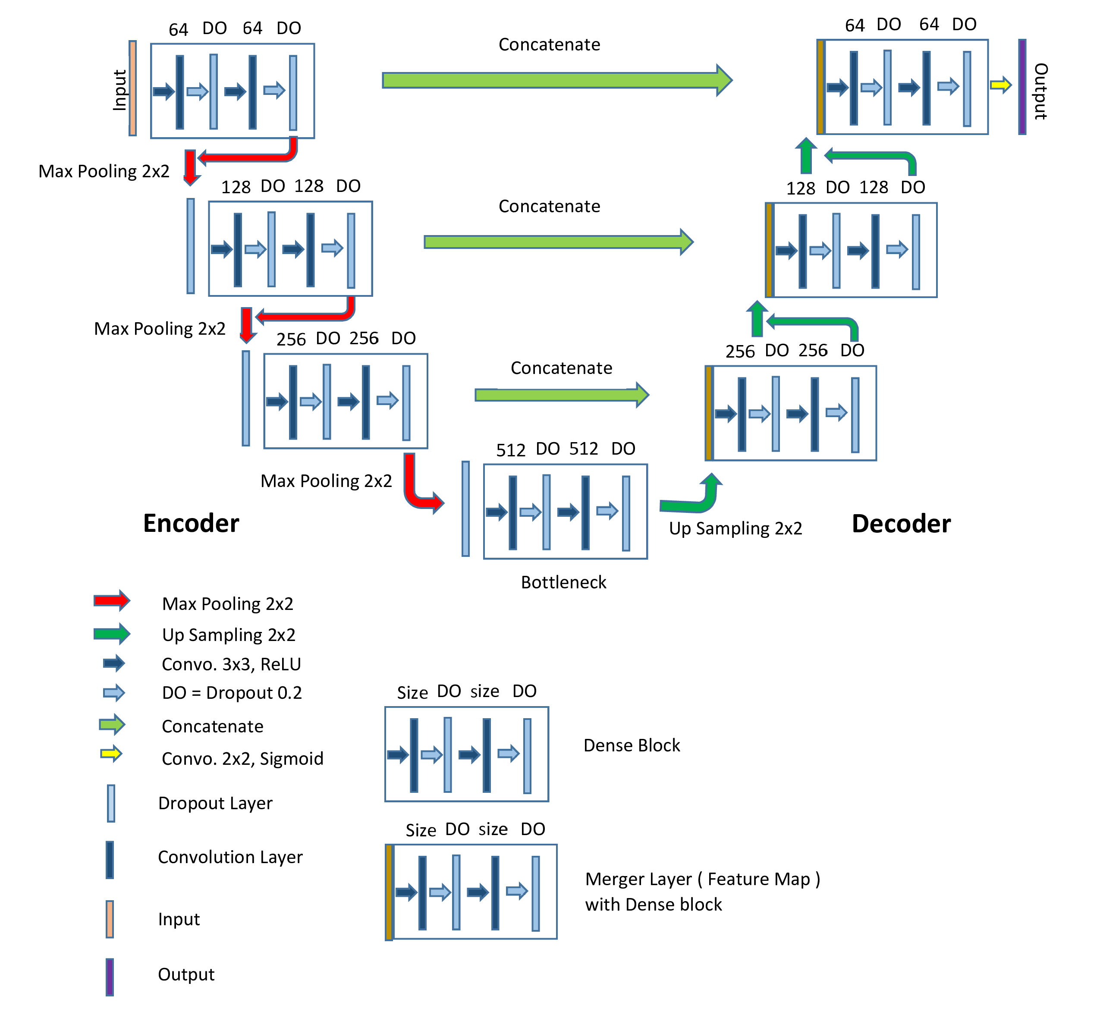
# Dense U-net Model Architecture
Reference : Huang, G., Liu, Z., and Weinberger, K. Q. (2016). Densely connected convolutional networks. CoRR, abs/1608.06993.

Slide 20
# Dense U-net Model initial experiments and Predicted results
Description | D_U_Experiements_EF3_LR04_S30 N_P_250 | D_U_Experiements_EF4_LR03_seed 42 N_P_250 | D_U_Experiements_EF4_LR04_seed 42 Dropout 0.2 kernel size 3 3 max pool size 2 2 N_P_300
Precision: | 0.8782 | 0.8792 | 0.8414
Recall (Sensitivity): | 0.6462 | 0.6662 | 0.7355
Specificity: | 0.9890 | 0.9881 | 0.9818
F1 Score: | 0.7445 | 0.7580 | 0.7849
Jaccard Index: | 0.5930 | 0.6103 | 0.6459
AUC: | 0.9695 | 0.9695 | 0.9712
Mean Dice Coefficient: | 0.7202 | 0.7286 | 0.7562
Mean Accuracy | 0.9515 | 0.9509 | 0.9532
Confusion Matrix: | [[72152584 803268] | [[71597782 865861] | [[85315262 1581578]
 | [ 3171850 5792298]] | [ 3156816 6299541]] | [ 3017197 8389963]]

Slide 21
# Dense U-net Model Final Configuration and predicted results
Configuration Description | Parameter values
Target image size | 512 x 512
Feature Type | Enhance_vessel
Data Augmentation method | flip & rotate [-45 , 45]
Patch Size | 128
Number of Patches (N_P) | 250
Normalization | TRUE
Learning rate | 1.00E-04
Batch Size | 8
Epoch | 5
Seed | 42
Threshold value for prediction | 0.5
Dense Unet model - input size | 128 ,128,1
Dense Unet model - layers | 64 , 128, 256 , 512
Dropout | 0.2
Unet model details | Convolution Layer ,Maxpooling2D, Dropout
Extracted Feature Parameters | Clip Limit: 1,tilegridsize:8x8,Kernel size: 3x3, sigmaX: 0, alpha:1, blurred:0,gamma:0
Post Process Parameters | Binary Opening (1,1), Binary Closing(1,1)
Description | D_U_Experiements_EF4_LR04_seed 42 Dropout 0.2 kernel size 3 3 max pool size 2 2 N_P_300
Precision: | 0.8414
Recall (Sensitivity): | 0.7355
Specificity: | 0.9818
F1 Score: | 0.7849
Jaccard Index: | 0.6459
AUC: | 0.9712
Mean Dice Coefficient: | 0.7562
Mean Accuracy | 0.9532
Confusion Matrix: | [[85315262 1581578]
 | [ 3017197 8389963]]

Slide 22
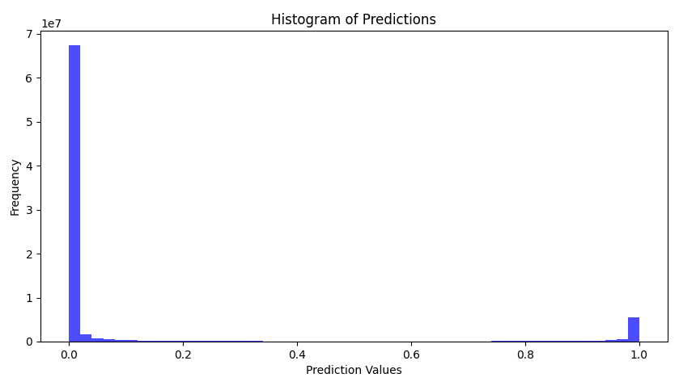
# U-net Model -Predicted value Histogram

Slide 23
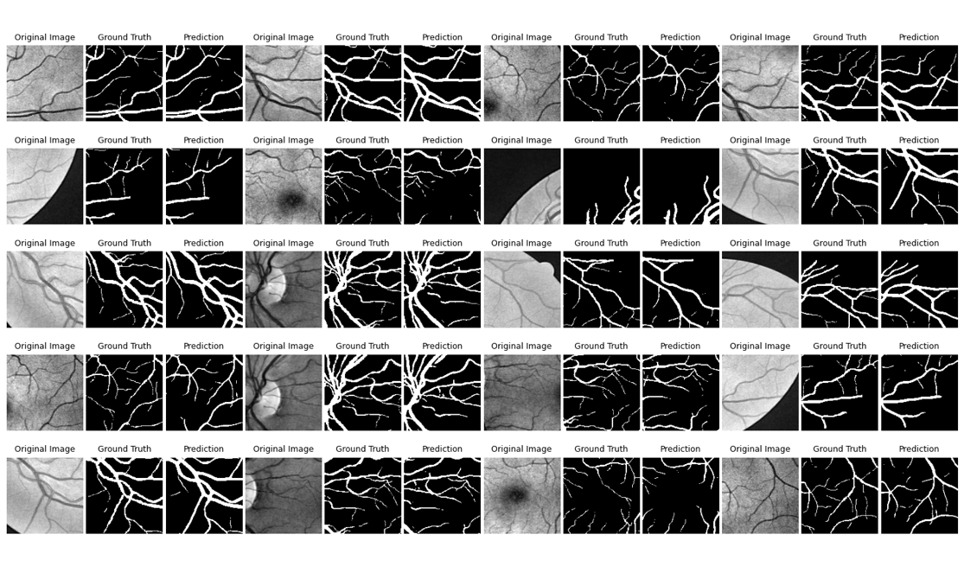
# U-net Model - Predicted patch compare with source image patches and ground truth image
patches

Slide 24
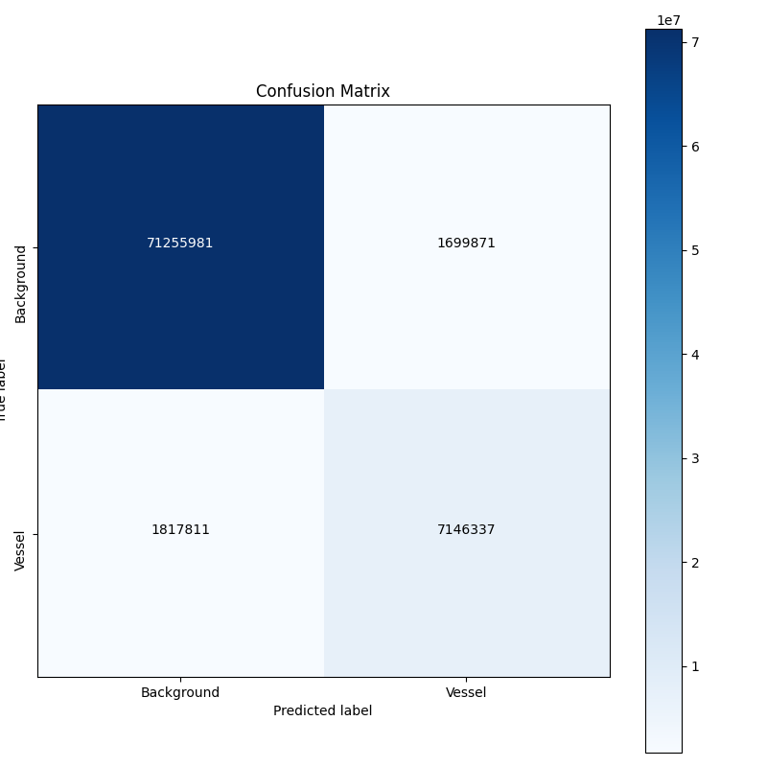
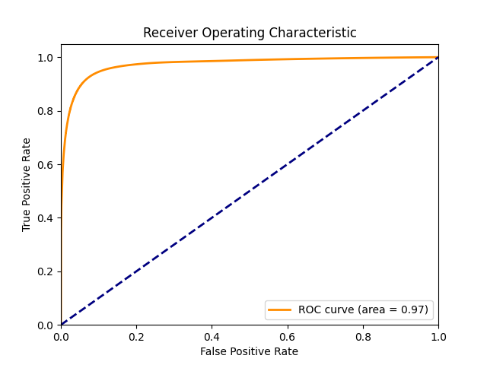
# U-net Model – ROC Curve and Confusion Matrix
ROC Curve
Confusion Matrix

Slide 25
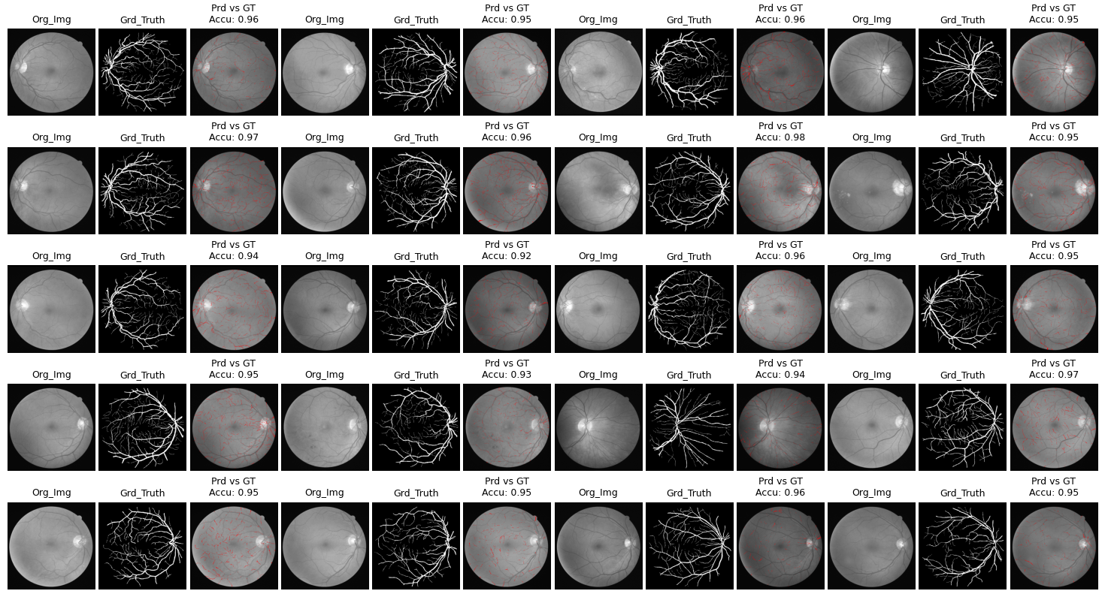
# U-net Model - Full Image compare with Predicted Image with highlights

Slide 26
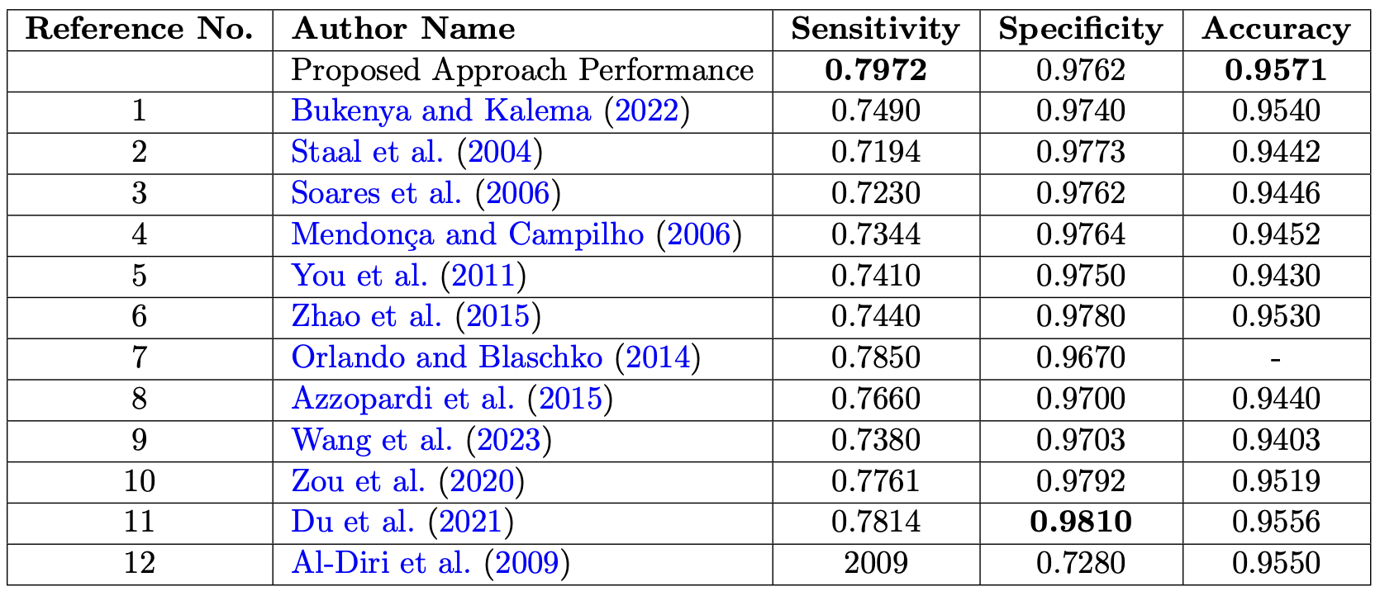
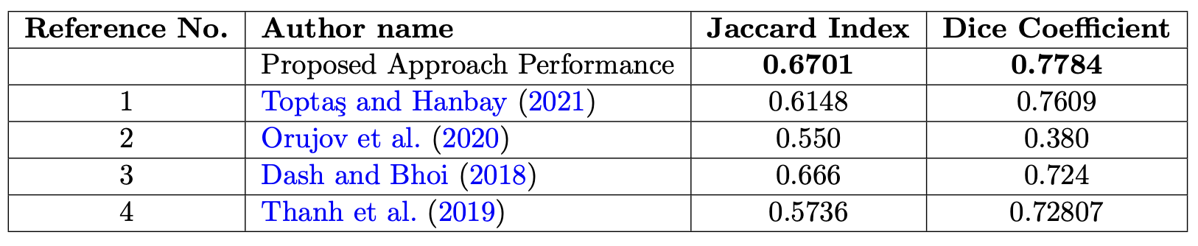
# Performance Comparison with similar work

Slide 27
# Conclusion
Superior Performance: The U-Net model outperformed the Dense U-Net model across multiple key metrics, demonstrating exceptional segmentation quality crucial for accurate diagnosis.
High Accuracy and Sensitivity: Achieved an accuracy of 95.71% and sensitivity of 79.72%, emphasizing the model's reliability in identifying vascular abnormalities in retinal images.
Clinical Relevance: The U-Net model’s high specificity (97.34%) and significant Jaccard index (67.01%) highlight its potential for practical clinical applications in early cardiovascular disease detection.
Potential for Non-Invasive Diagnosis: The study reinforces the value of deep learning in medical imaging, presenting the U-Net model as a promising tool for non-invasive, precise cardiovascular disease diagnosis.

Slide 28
Question & Answer

